Slide 1

Introducing Azure Cloud Adoption Framework
Cloud Scale Analytics

Slide 2
Agenda
Everything is code (IaC)
What is the Cloud Adoption Framework
The cloud foundation
Scenarios
What is the Cloud Scale Analytics Scenario
Why should we use it

Slide 3

Everything is code
ARM
Terraform
Bicep
Landing Zone blueprints available for all languages

Slide 4
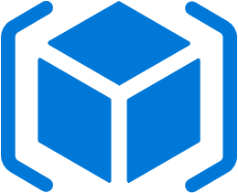
Everything is code
ARM – Azure Resource Management
the core of Azure services
JSON
wordy
All CAF blueprints available as ARM templates

Slide 5

Everything is code
Hashicorp Terraform
open source, multi-cloud, popular
declarative language
can create modules
generates ARM templates when compiled
new Azure services can take time to get support
New module to import Azure resources into Terraform

Slide 6
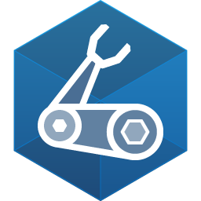
Everything is code
Bicep
«new» declarative language from MS (v0.4)
can create modules and libraries
generates ARM templates when compiled
supports all new Azure services (allegedly…)

Slide 7
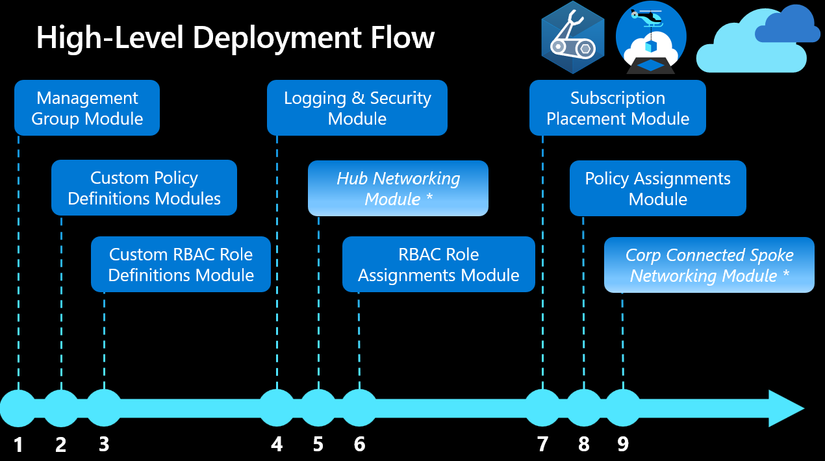

Slide 8
Everything is code
This is where a demo would appear

Slide 9

Cloud Adoption framework
CAF is Microsoft’s set of recommendations, tools, blueprints and best practices.
Builds on top of WAF – Well Architected Framework
Every cloud vendor has their own (surprise…)
Dette bildet av Ukjent forfatter er lisensiert under CC BY-NC-ND

Slide 10
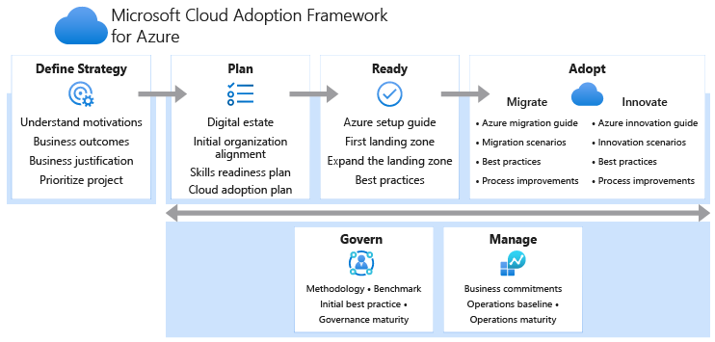
Cloud adoption framework Life cycle

Slide 11
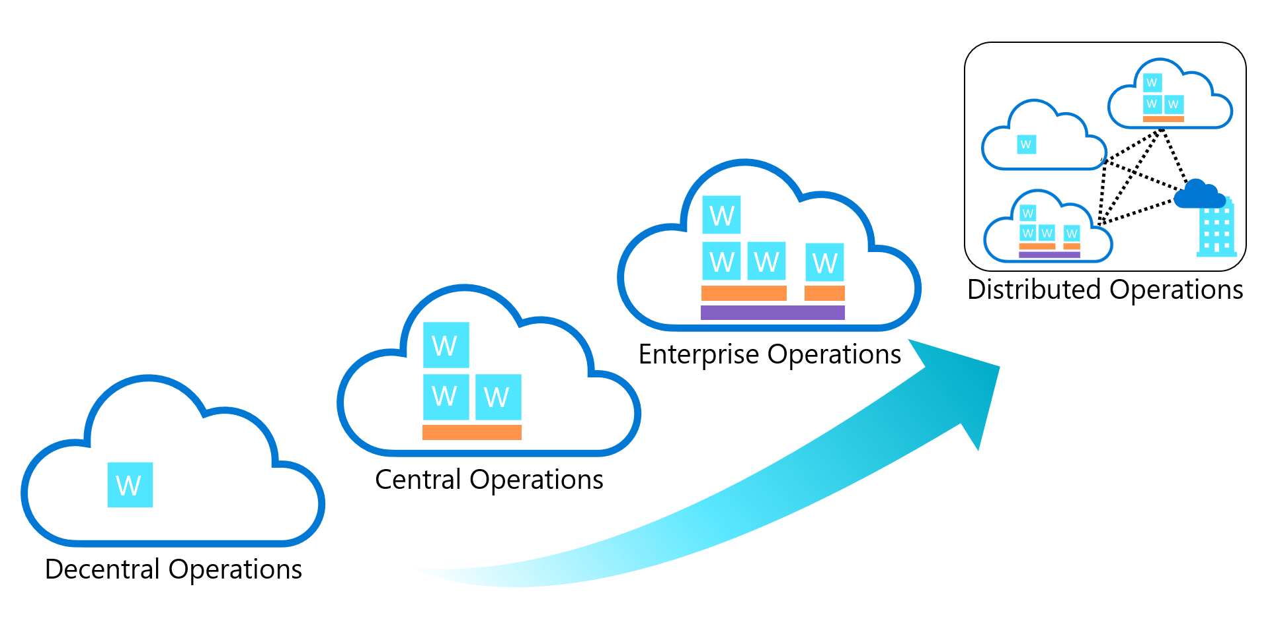
Cloud adoption framework - READY
Focus for today is READY
Select your operating model

Slide 12
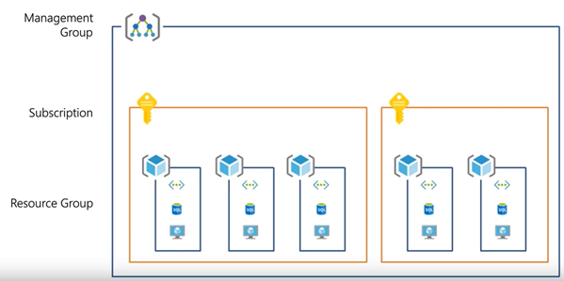
CLOUD Adoption Framework
Basics on Azure hierarchies
Tenant
Management Groups
Subscription(s)
Resource Groups

Slide 13
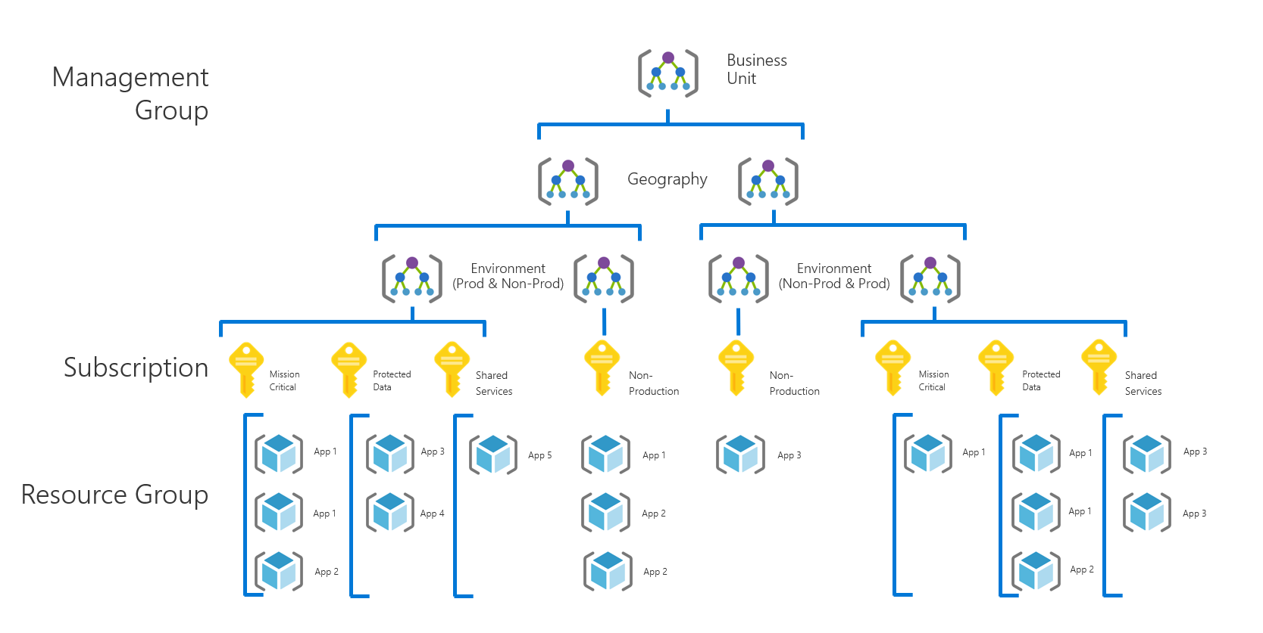
Cloud adoption framework

Slide 14
Cloud adoption framework
Common terminology
Platform
The whole Azure setup – not to be confused with data platform...
Landing Zone(s)

Slide 15
Cloud adoption framework - READY
Build your Landing Zone
What is a landing zone?
Microsoft defines it this way: “A landing zone is an environment for hosting your workloads, preprovisioned through code. “
It is your target architecture for your cloud environment.
Scalable
Modular

Slide 16
Design Considerations
Environment Design Areas
Compliance Design Areas
Azure Billing & AD Tenant
Security
Identity & Access Management
Management
Network Topology & Connectivity
Governance
Resource Organization
Platform Automation & DevOps

Slide 17
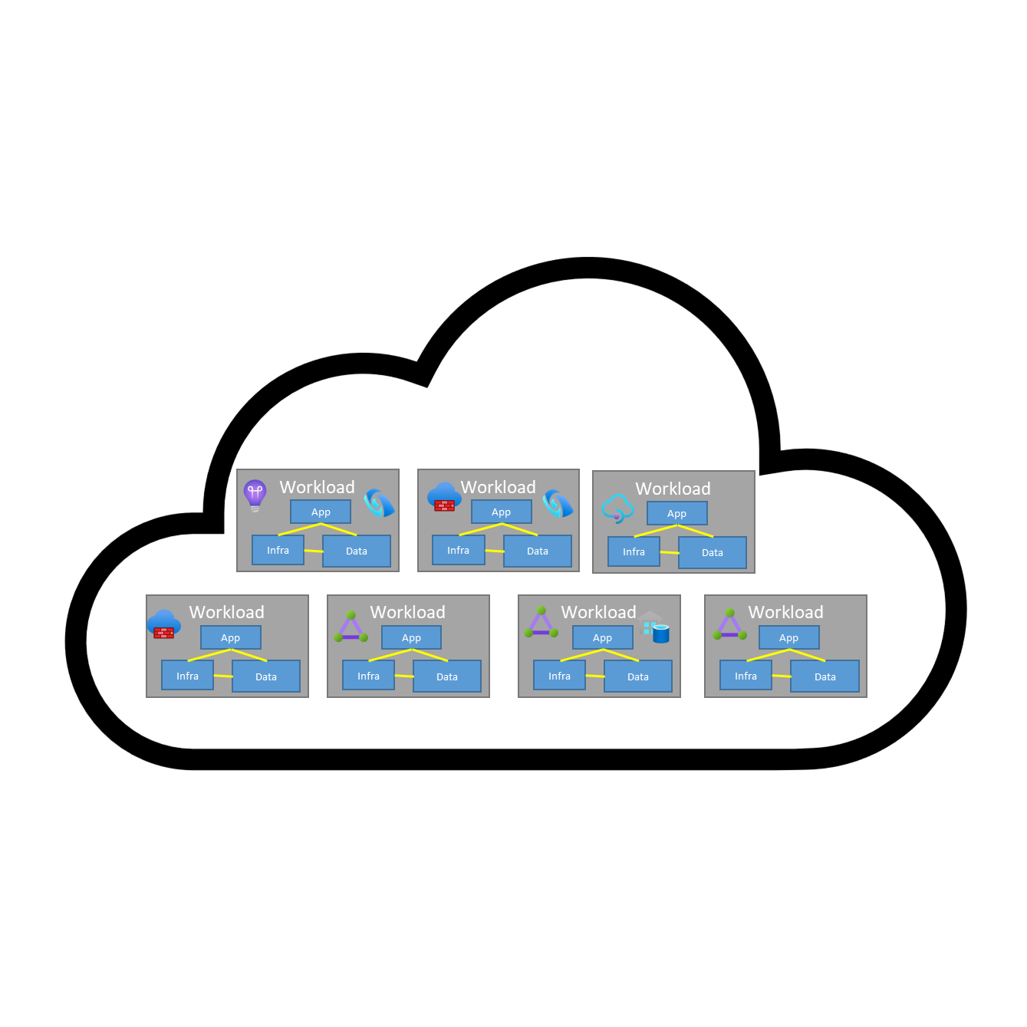

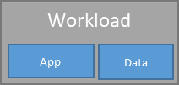
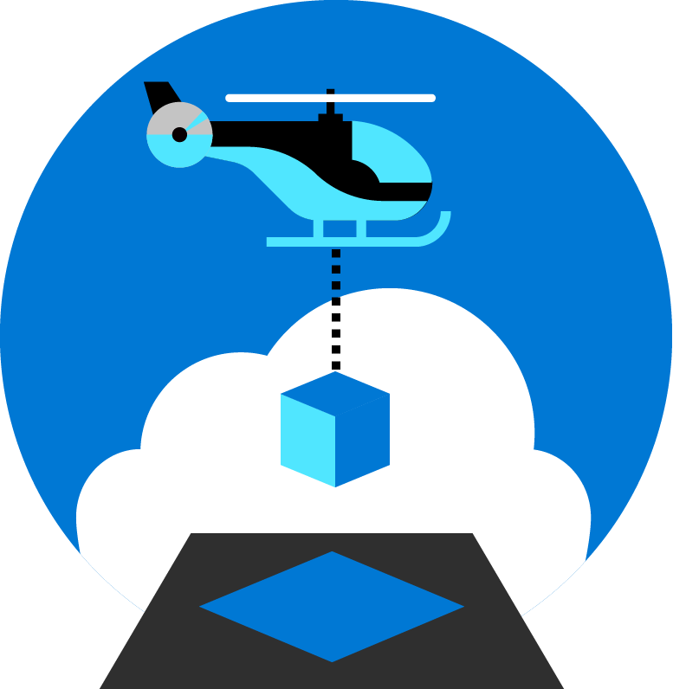
Cloud adoption framework - READY
Each landing zone supports one ore more applications in your cloud portfolio using the inherited controls
Workload
App
Landing Zone Accelerator
Infra
Data
Centrally managed landing zone
Tech Platform landing zone
Workload landing zone
Azure landing zone implementations establish an enterprise control plane by defining environmental configuration & controls required for compliant operations management

Slide 18
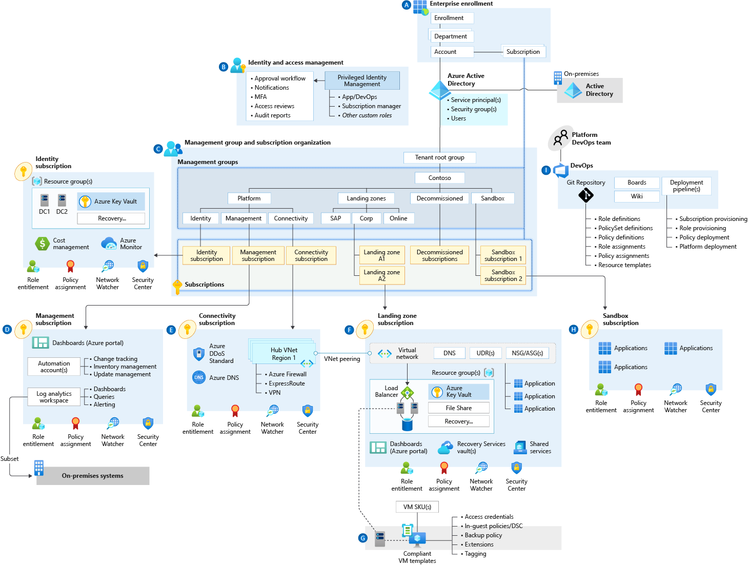
Cloud adoption framework - READY

Slide 19
Cloud adoption framework - READY
This is where a demo would appear

Slide 20
Cloud adoption framework
Common terminology
Platform
Landing Zone(s)
Hubs
The networking core of your setup – common services
Spokes
The application or function specific area (Data services/Integration services...)

Slide 21
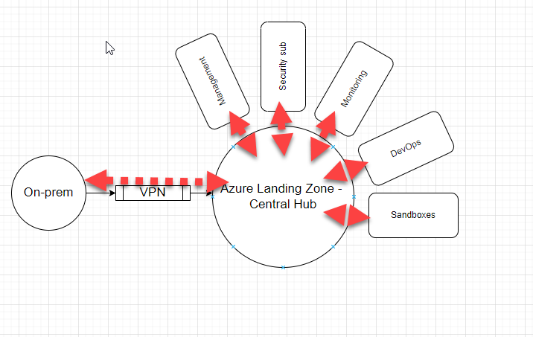
Cloud Adoption Framework Platform
Hub - Spoke

Slide 22
Cloud Adoption Framework Platform
Nifty toolbox
Azure Naming Tool
Various templates
Lots of blueprints – in all 3 IaC languages

Slide 23

The scenarios

Slide 24
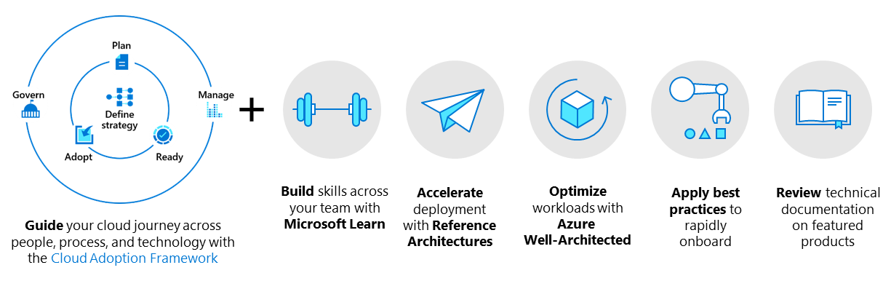
The Scenarios – Enterprise scale

Slide 25
The Scenarios – Enterprise scale
Azure VMware Solution
Hybrid and multi-cloud
Modern application platform
SAP (on Azure)
Retail industry
Cloud Scale Analytics (formerly Data Management & Analytics)
Note! These are all targeted towards Enterprise scale!

Slide 26
TODAY’s Scenario: Cloud scale analytics
Modern data platforms consists of lots of moving parts

Slide 27
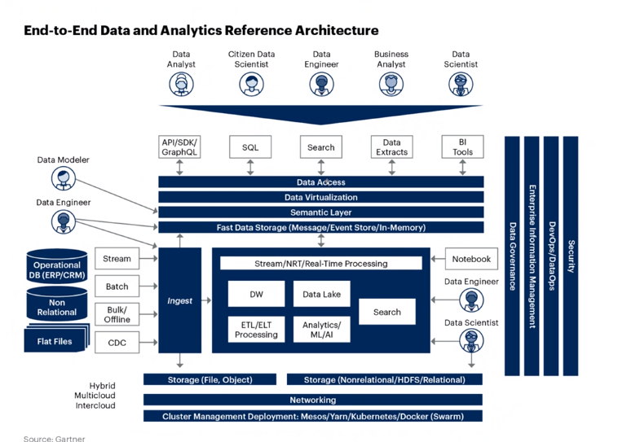
TODAY’s Scenario: Cloud scale analytics
Modern data platforms consists of lots of moving parts

Slide 28
TODAY’s Scenario: Cloud scale analytics
Modern data platforms consists of lots of moving parts

Slide 29
TODAY’s Scenario: Cloud-scale analytics
Modern data platforms consists of lots of moving parts
i.e. data lakehouse or data mesh
But while architectural complexity increases, the ability to plan and control the complexity is in your hands.
With IaC and the CAF accelerators - or scenarios you get help

Slide 30
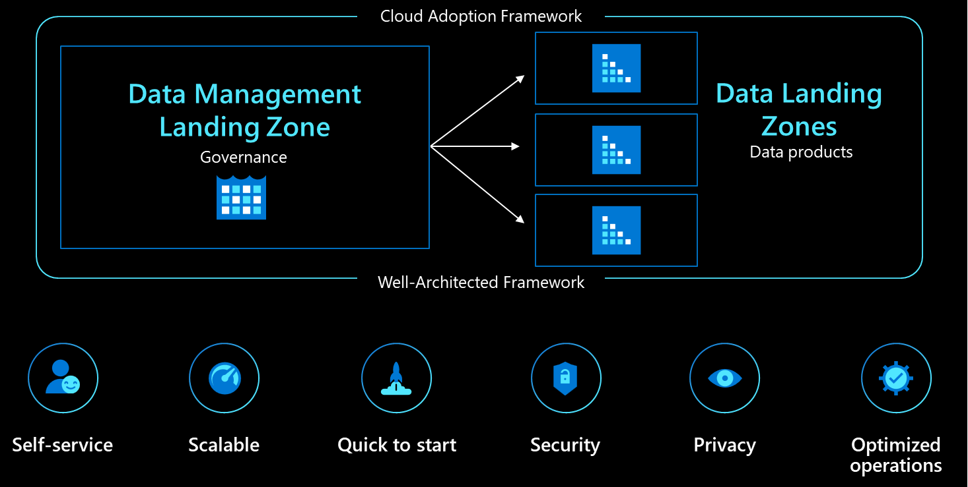
TODAY’s Scenario: Cloud-scale analytics

Slide 31
Cloud adoption framework - READY
This is where a demo would appear

Slide 32
TODAY’s Scenario: Cloud scale analytics
Cloud scale is targeting “data mesh”-like patterns.
But – as everything else CAF-related – this is free-to-adapt code
5 modules
Data Management Zone
Data Landing Zone(s)
Data Integration – batch
Data Integration – stream
Data Product – Analytics & Data Science

Slide 33
TODAY’s Scenario: Cloud scale analytics
Data Management Zone
One per scenario deployment
Creates one subscription off your Azure hub
All management services – as defined by Microsoft

Slide 34
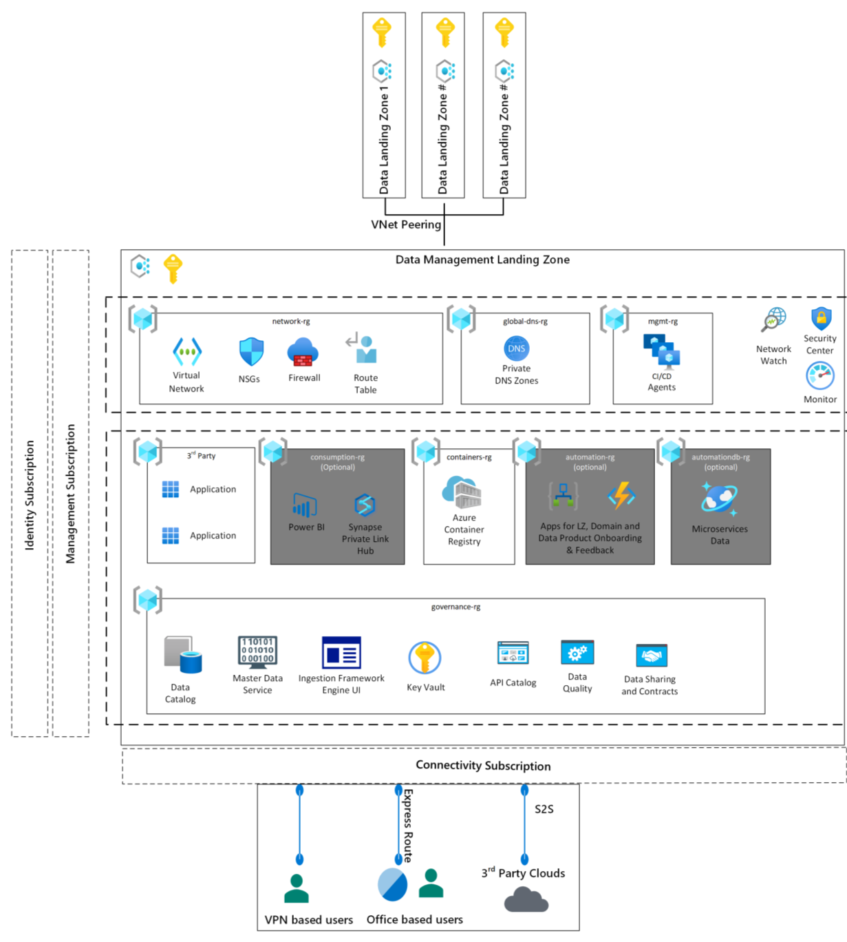
TODAY’s Scenario: Cloud scale analytics

Slide 35
TODAY’s Scenario: Cloud scale analytics
2. Data Landing Zone
One to many – depending on your organization’s needs
This is where your data is persisted – and workloads are executed
storage services
Ingestion services
Management services (networking, monitoring…)

Slide 36
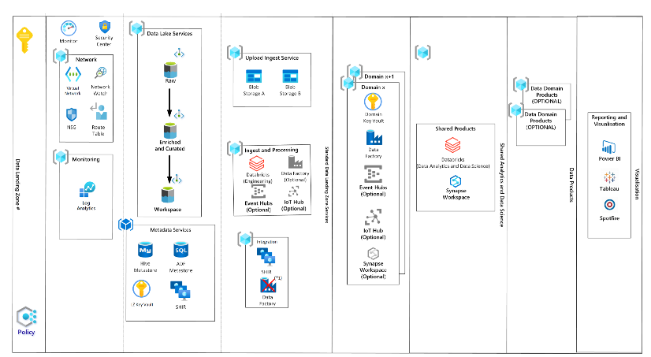
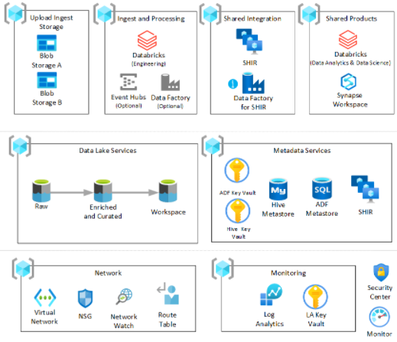
TODAY’s Scenario: Cloud scale analytics

Slide 37
TODAY’s Scenario: Cloud scale analytics
3 . Data Integration – batch & 4. Data Integration - stream
One to many – depending on your organization’s needs
These are deployed as resource groups within your Data Landing Zone
storage services
data orchestration – Data Factory & Event hub /IoT Hub
transformation – Data Factory / Synapse / Databricks / Stream Analytics
shared runtime services
metastores

Slide 38
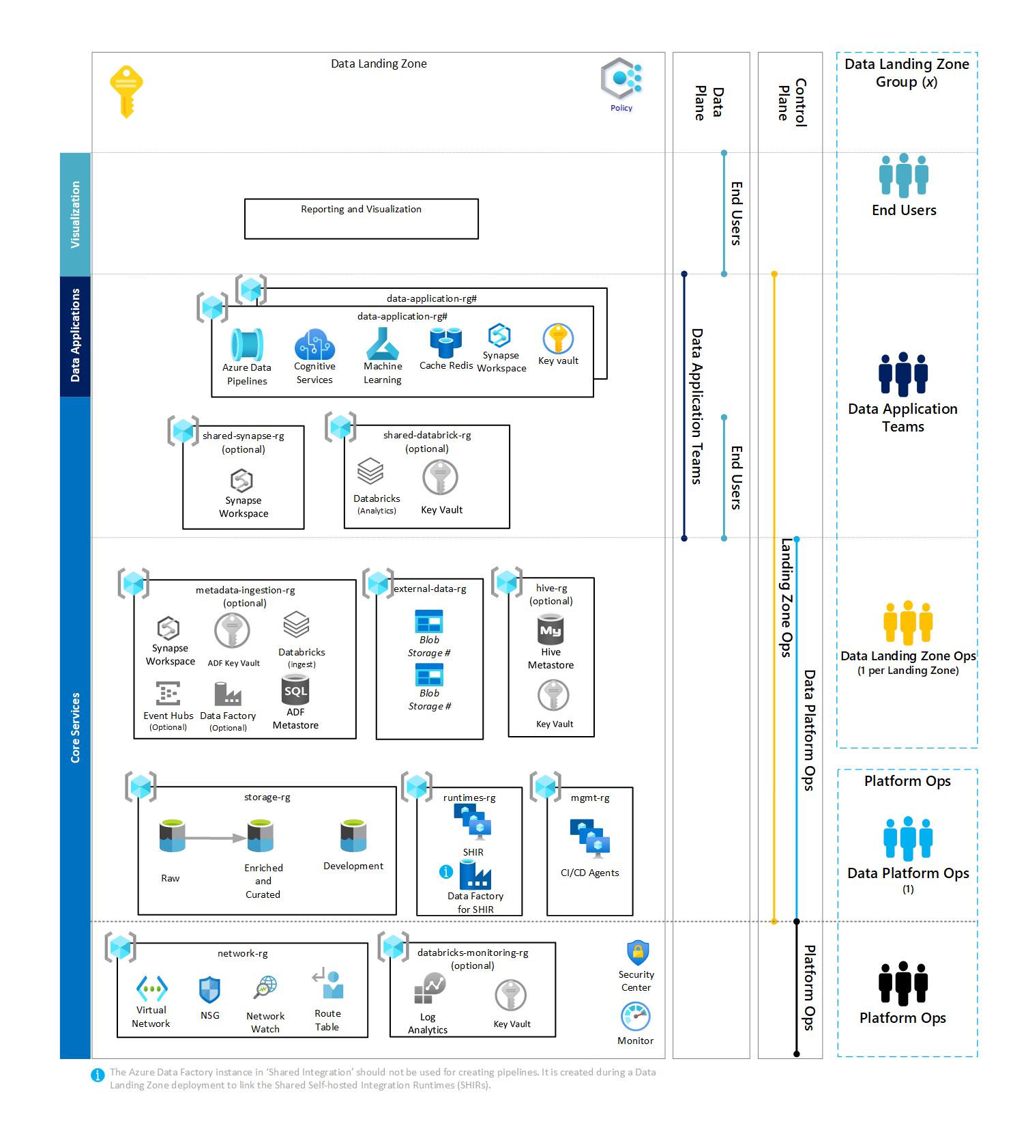
TODAY’s Scenario: Cloud scale analytics

Slide 39
TODAY’s Scenario: Cloud scale analytics
5. Data Product – Analytics & Data Science
One to many – depending on your organization’s needs
These are deployed as resource groups within your Data Landing Zone(s)
Synapse Workspace
Databricks Workspace
Key vaults
Data Science services (Azure ML, Cognitive services ++)
Storage account
Supports independent data teams and data mesh approach

Slide 40
TODAY’s Scenario: Cloud scale analytics

Slide 41
Cloud adoption framework - READY
This is where a demo would appear

Slide 42
TODAY’s Scenario: Cloud scale analytics
Why should you use CAF in general and this scenario specifically?
Baseline infrastructure and policy services best practices
Same language as infra engineers – better co-operation
Infrastructure as code – control your services with CI/CD
Implement cost management – down to product/team level
Supports various data architectures, including data mesh
Data as product
Make the code your own – fit your needs

Slide 43
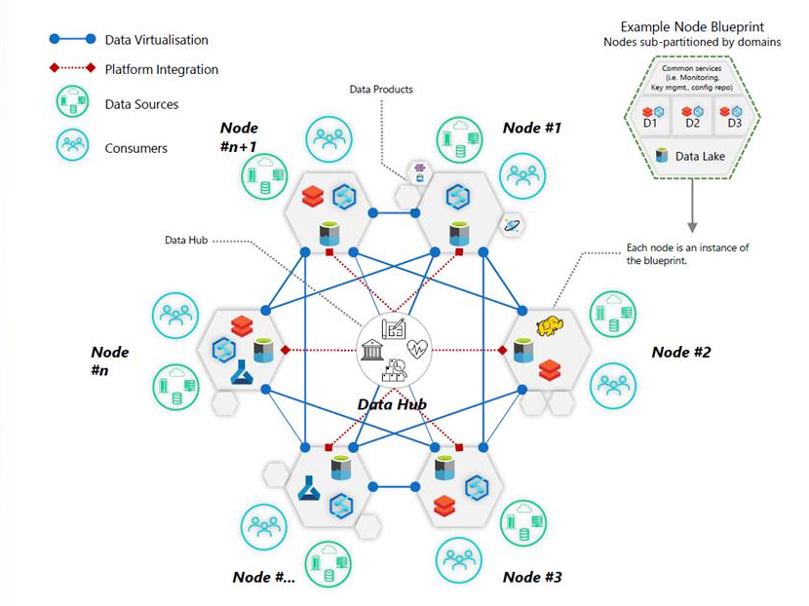
TODAY’s Scenario: Cloud scale analytics

Slide 44
The end
Questions?

Slide 45




Johan Ludvig Brattås
Principal Solution Architect
Founder – DataSaturdays Co-organizer – SQLSatOslo Leader – MDPUG Oslo Frequent volunteer in general
@intoleranse
/johanludvig
johan-ludvig.brattas@capgemini.com
capgemini.com

Slide 46
Links
https://docs.microsoft.com/en-us/azure/cloud-adoption-framework/
https://docs.microsoft.com/en-us/azure/cloud-adoption-framework/scenarios/cloud-scale-analytics/
https://github.com/Azure/Enterprise-Scale
https://github.com/Azure/ALZ-Bicep
https://github.com/Azure/data-management-zone

